Slide 1
Defining Discipleship
First Baptist Church of Havelock

Slide 2
Dietrich Bonhoeffer
“Discipleship means adherence to Christ, and, because Christ is the object of that adherence, it must take the form of discipleship.”

Slide 3
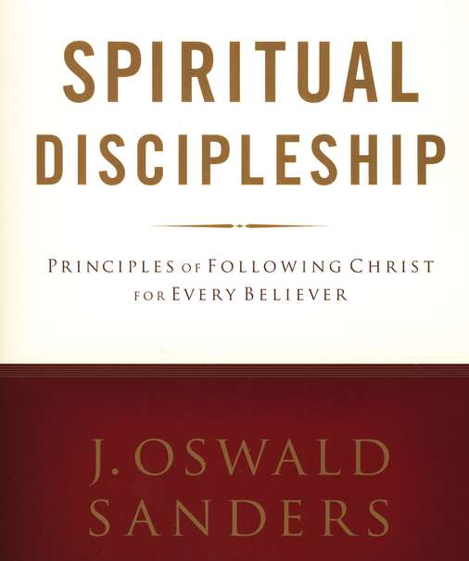
J. Oswald Sanders
“A disciple is simply a ‘learner’. … We learn in order to put into practice what we have learned. That attitude is the essence of true discipleship.”

Slide 4
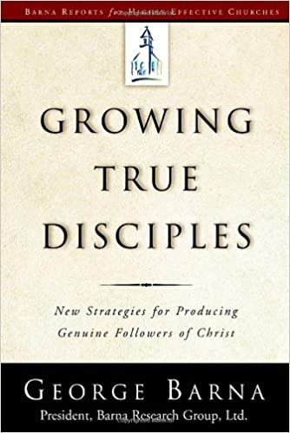
David Wardell & Jeff Leever
“A disciple is wholly devoted to Him.” (Jesus Christ)
George Barna
“We might define discipleship as becoming a complete and competent follower of Jesus Christ”

Slide 5
Michael Wilkins
Disciple ~ one who has:
Come to Jesus for eternal life,
Claimed Jesus as Savior and God,
And embarked upon the life of following Jesus.

Slide 6
Waylon Moore
“Jesus defines the word disciple in three ways.”
A Christian who is involved in the word of God on a continual basis.
One who lays down his life for others.
Abides daily in a fruit-bearing union with Christ.

Slide 7
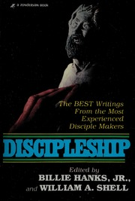
Discipleship is the kind of life God expects of us as Christians. We are called to be followers of Jesus Christ – Disciples. But we are also mandated to “go and make disciples”
“What percentage of your Baptist laity would normally win someone to Jesus Christ during any given year?”
Fewer than 5% of the laity and clergy combined lead anyone to a saving knowledge of Christ.

Slide 8
Bill Hull
Faith means to follow
Following isn’t short term
Discipleship isn’t a program or an event
It’s a way of life
It’s not for a limited time
It’s for our whole life
Discipleship isn’t for beginners alone
Its’ for ALL believers for EVERY day of their life.

Slide 9
Simon Sinek – The Golden Circle

Slide 10
Terms to remember ~ pg. 218-219
Discipleship – The process of belonging to, believing in and becoming like Jesus Christ.
Child Disciple – A child who loves Jesus for the rest of his or her life.
Resilient Child Discipleship – The process of a Christ-follower committing meaningful, intentional and consistent time and space to a child or a group of children so that they may know who Jesus is, are known by a body of believers (Belong), to place their faith in Jesus, apply the Word of God (Believe) and to reproduce their own discipleship (Become), so that a third spiritual generation can lead and love like Jesus Christ.

Slide 11
Are our kids becoming Christian disciples, or is culture engulfing them?

